Slide 1
Git
Andy Kelsey

Slide 2
Background
CIF-348 Version Control System Assessment
Evaluating Git as a potential replacement / supplement to SVN
Medtronic BluLite
Android OS development
Customer specifically requested Git
Used Cloud implementation (GitLab and AWS CodeCommit)

Slide 3

Git
Open source distributed revision control system
Created by Linus Torvalds and other Linux kernel developers
Launched in 2005
Replaced BitKeeper as SCM system for the Linux kernel

Slide 4
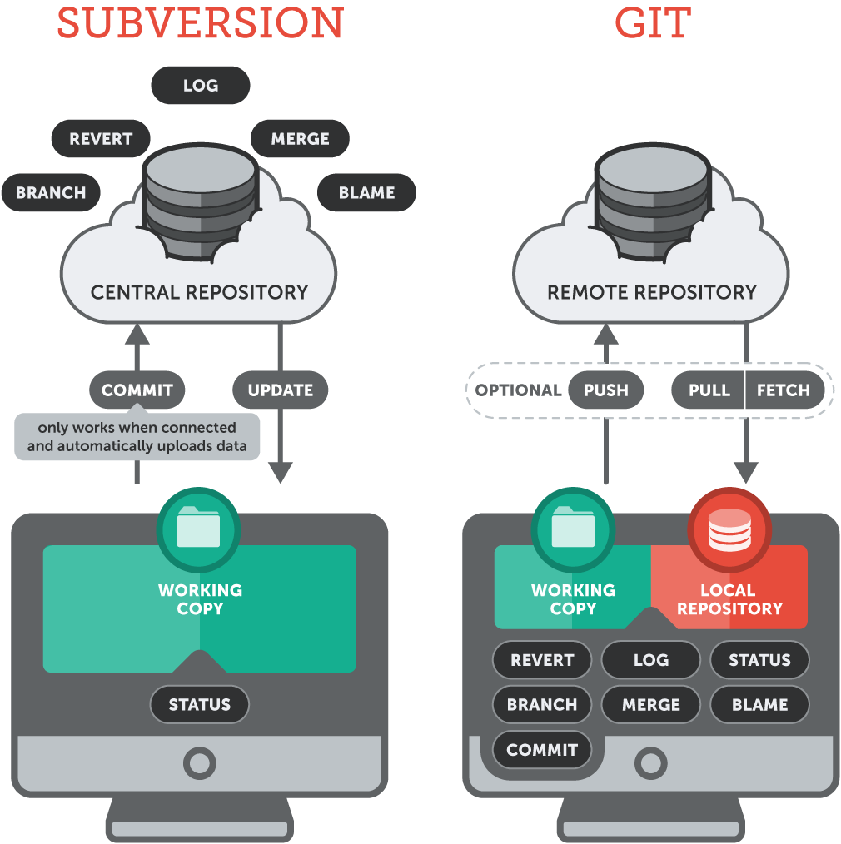
Centralized vs Distributed

Slide 5
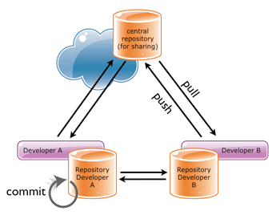
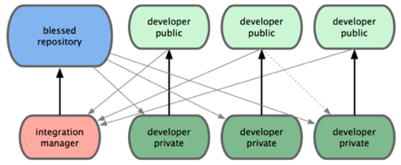
Why use Distributed?
Each developer has their own local repository
This is separate from their “working copy”
Allows commits off-line
Can be configured to use a remote “SVN style” repository
Speed increase for commits, logs, diffs, update, blame
Complete local back-up
hard to lose data
Can use different workflows
E.g. integrator approach

Slide 6
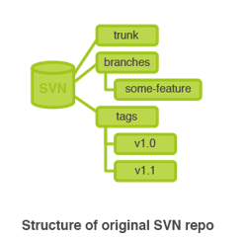
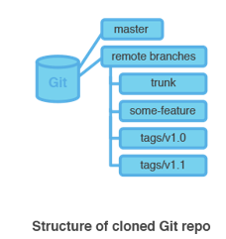
Repository Structure
SVN
trunk
branches
A copy of the project in another folder
tags
URLs are used to point to all locations.
Git
Consist of a single “.git” folder
Located in root of a project
Branches/tags are addressed via commands
A pointer to a certain revision
URL only points to the location of the repository

Slide 7
Committing
SVN
Can only commit when connected to central repository
Commit gets instantly transferred to central repository
Commit gets assigned an ascending revision number
Git
Can commit to local repository whenever
Use “push” command to send commit to another repository
Commit gets assigned a SHA-1 id
Used for data integrity
Commit id will change if the commit or history changes
Unique “staging area” which allows part of files to be committed

Slide 8
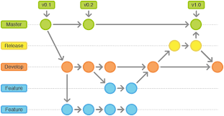
Branching
SVN
Remote branches only
Forces branches to be visible to all repository users
Git
Local and remote branches
Can create a local branch, refine it, and then distribute it to a remote repository

Slide 9
Rebasing vs Merging
Rebasing
Makes sure new commits go on top of the public branch (cleaner history)
Allows you to stay in sync on local topic branches
Commits are given a new SHA-1 id (rewriting history)
Merging
Same operation as SVN currently offers
Should be used on public branches to retain history

Slide 10
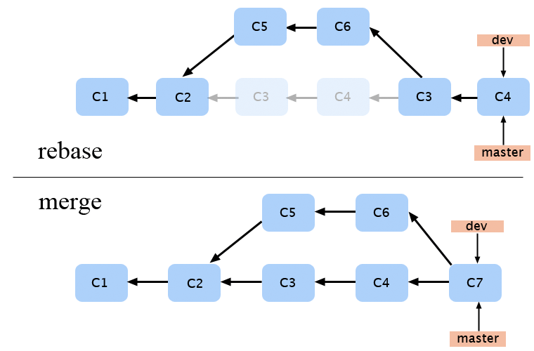
Rebasing VS Merging

Slide 11
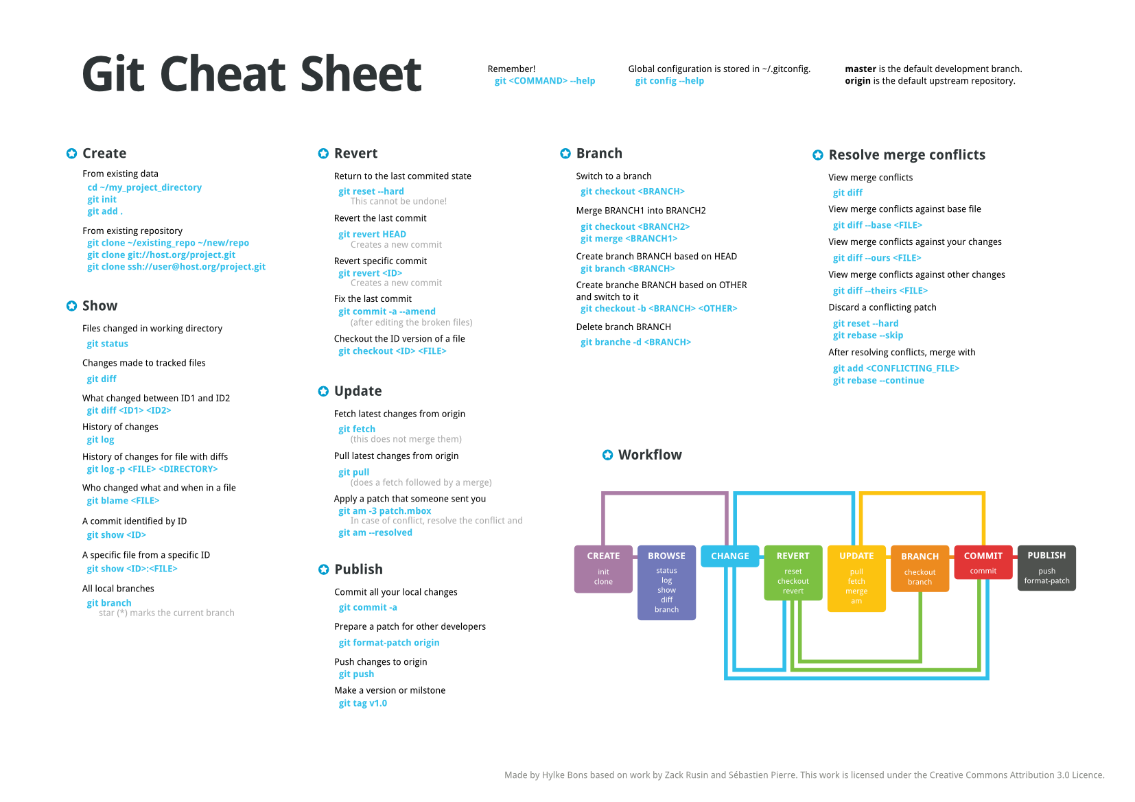
Commands

Slide 12
Pros and Cons
PROS | CONS
Speed increase for commits, diff, log, update, blame, branch, revert | Speed decrease for clone (SVN checkout)
Less hard disk usage – (E.g. Mozilla project 30x smaller using git) | Less UI available. TortoiseGit was recently released as a port of TortoiseSVN.
Data assurance with SHA-1 ids assigned to each commit | More complexity and higher learning curve
Branching and merging can done locally | Commit ids are not in sequential order
Local repository – Distributed | No inherent locking ability
Multiple back-ups
Retain history when importing SOUP

Slide 13
Questions?

